Slide 1
CE6002
E-tivity 2
Q&A Session

Slide 2
Summary E-tivity 1
Introduce the VC dimension at a conceptual level (with some maths)
Encourage you to think about your E-tivity results with the theory of generalisation in mind

Slide 3
Summary E-tivity 1 – What do we know?
The Hoeffding Inequality puts a bound on the difference between E_{in} and E_{out}.
The nice: for one hypothesis this allows us to say we are likely to do as well out-of-sample as in-sample.
The not-so-nice: Hoeffding doesn’t allow us to say anything about a situation in which we try multiple hypotheses before arriving at a final one.
The ‘M’ introduced in the Hoeffding Bound depends on the number of hypotheses in the set, often infinite.
All that Hoeffding and puffing in vain?? (credits: Martin Power)

Slide 4
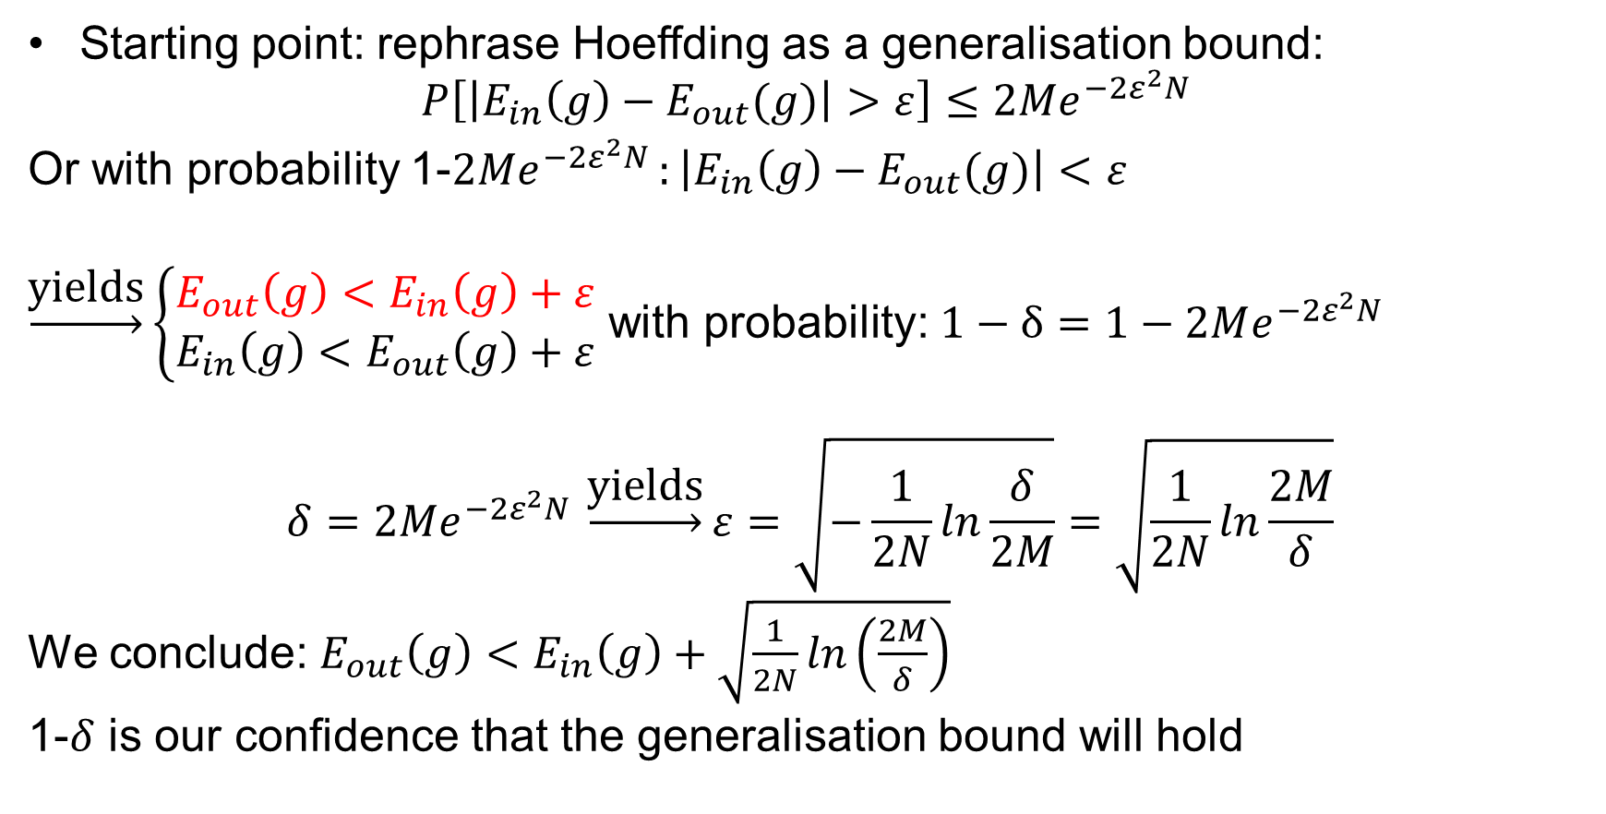
The generalisation bound
Starting point: rephrase Hoeffding as a generalisation bound:
$$P\left[\left|E_{in}\left(g\right)−E_{out}(g)\right|>ε\right]≤2Me^{−2ε^{2}N }$$
Or with probability 1-$2Me^{−2ε^{2}N }:\left|E_{in}\left(g\right)−E_{out}(g)\right|<ε$
$\underset{→}{\text{yields}}\left\{\begin{aligned}E_{out}\left(g\right)<E_{in}\left(g\right)+ε \\ {E_{in}\left(g\right)<E}_{out}\left(g\right)+ε\end{aligned}\right.$ with probability: $1−δ=1−2Me^{−2ε^{2}N }$
$$δ=2Me^{−2ε^{2}N }\underset{→}{\text{yields}}ε=\sqrt{−\frac{1}{2N}ln\frac{δ}{2M}}=\sqrt{\frac{1}{2N}ln\frac{2M}{δ}}$$
We conclude: $E_{out}\left(g\right)<E_{in}\left(g\right)+\sqrt{\frac{1}{2N}ln\left(\frac{2M}{δ}\right)}$
1-$δ$ is our confidence that the generalisation bound will hold

Slide 5
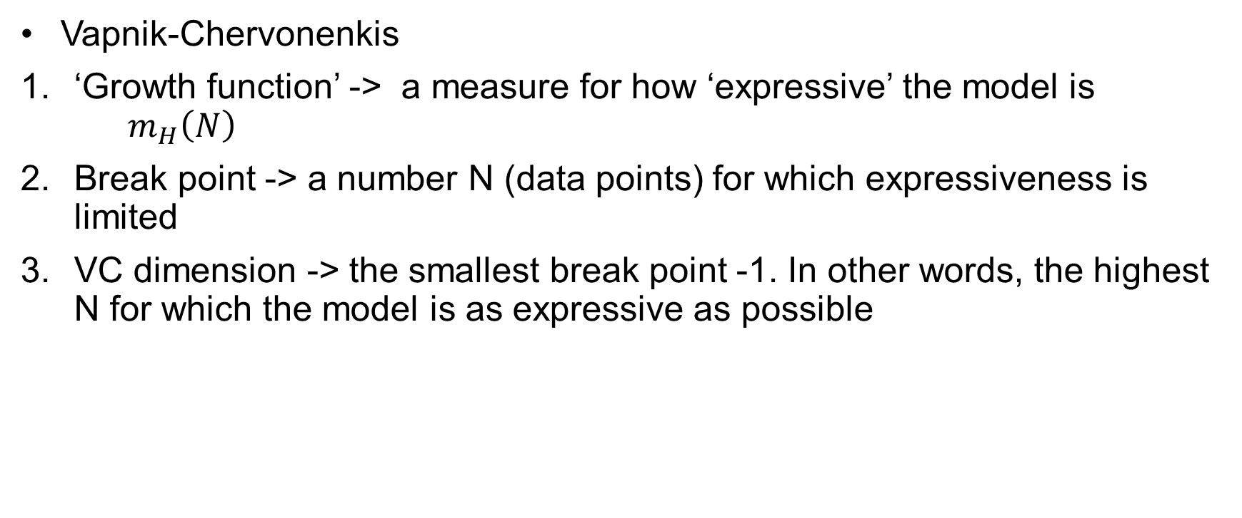
The VC dimension
Vapnik-Chervonenkis
‘Growth function’ -> a measure for how ‘expressive’ the model is $m_{H}\left(N\right)$
Break point -> a number N (data points) for which expressiveness is limited
VC dimension -> the smallest break point -1. In other words, the highest N for which the model is as expressive as possible

Slide 6
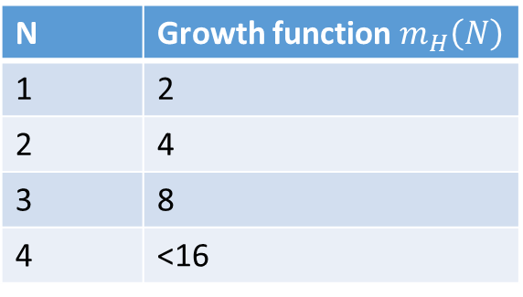
Growth functions and break points (for classification)
Total number of ‘dichotomies’ 2^{N} = maximum expressiveness
2D perceptron growth function:
?
N=2 -> 4 dichotomies
N=3 -> 8 dichotomies
N=1 -> 2 dichotomies
N | Growth function $m_{H}\left(N\right)$
1 | 2
2 | 4
3 | 8
4 | <16
Perceptron ‘shatters’ these sets
Break point!
When trying to shatter a dataset, you may find the most favourable arrangement of data points. A model need only shatter one example of N points!

Slide 7
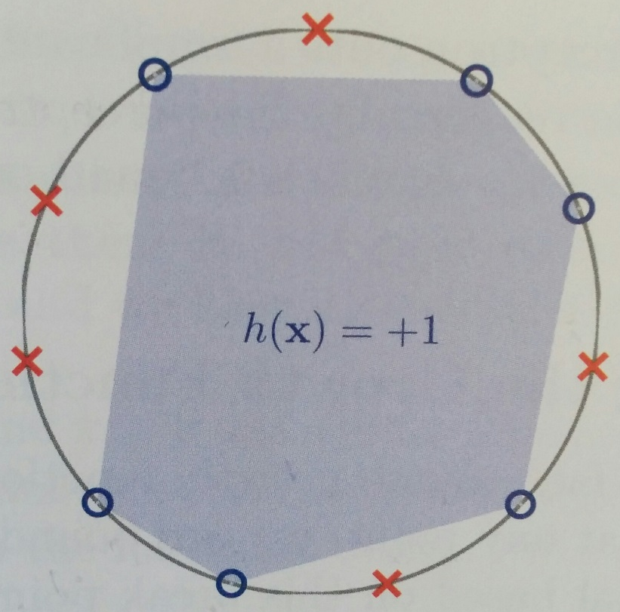
Growth functions and break points (for classification)
Some hypotheses sets do not have a break point. Take for example the hypothesis set of all convex sets in 2D (convex means that a line connecting any two points in the set itself lies fully within the set).
Non-convex set

Slide 8
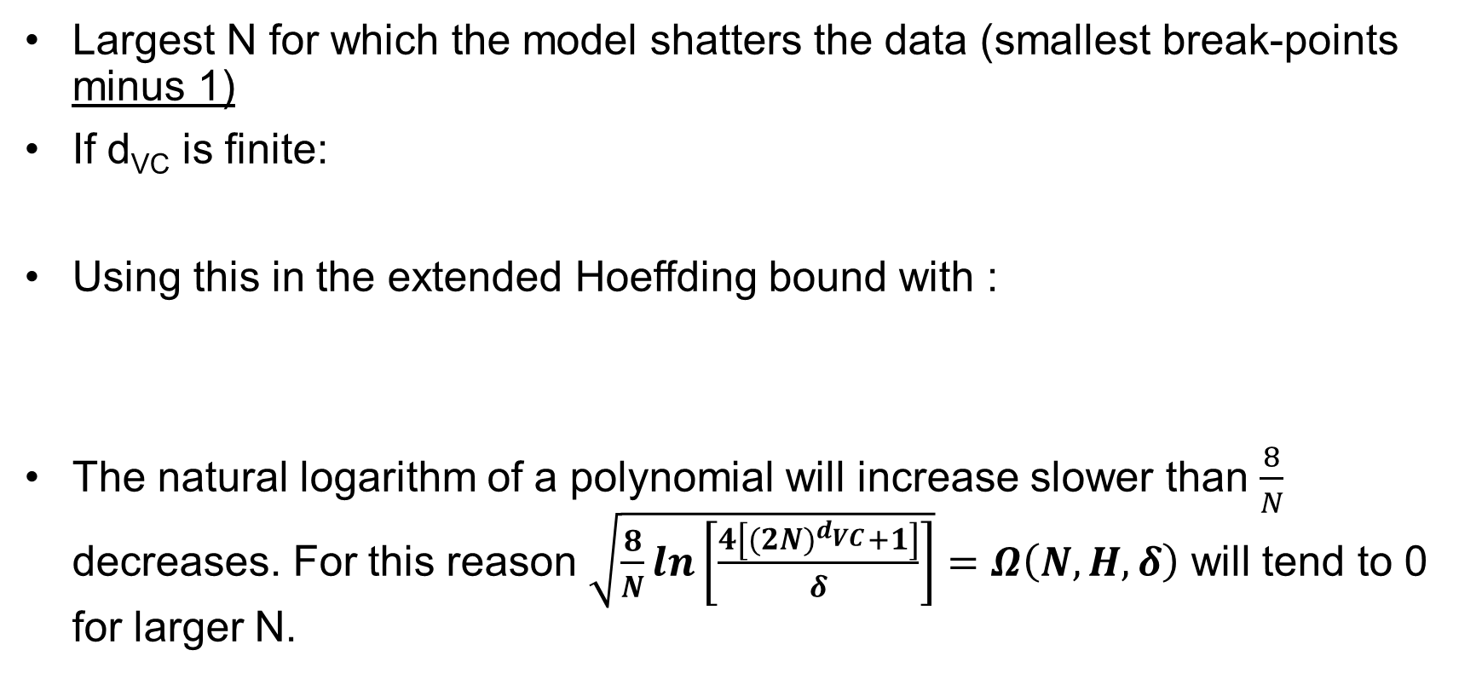
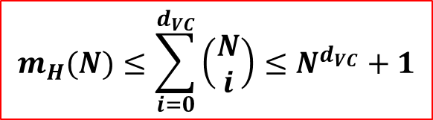
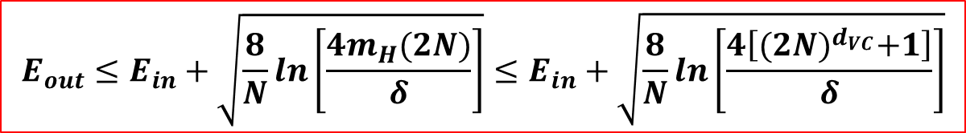
VC dimension, d_{VC}
Largest N for which the model shatters the data (smallest break-points minus 1)
If d_{VC} is finite:
Using this in the extended Hoeffding bound with :
The natural logarithm of a polynomial will increase slower than $\frac{8}{N}$ decreases. For this reason $\sqrt{\frac{8}{N}ln\left[\frac{4\left[{(2N)}^{d_{VC}}+1\right]}{δ}\right]}=Ω\left(N,H,δ\right)$ will tend to 0 for larger N.
$$m_{H}(N)≤\sum_{i=0}^{d_{VC}}{\left(\begin{matrix}N \\ i\end{matrix}\right)≤N^{d_{VC}}+1}$$
$$E_{out}≤E_{in}+\sqrt{\frac{8}{N}ln\left[\frac{4m_{H}(2N)}{δ}\right]}≤E_{in}+\sqrt{\frac{8}{N}ln\left[\frac{4\left[{(2N)}^{d_{VC}}+1\right]}{δ}\right]}$$

Slide 9
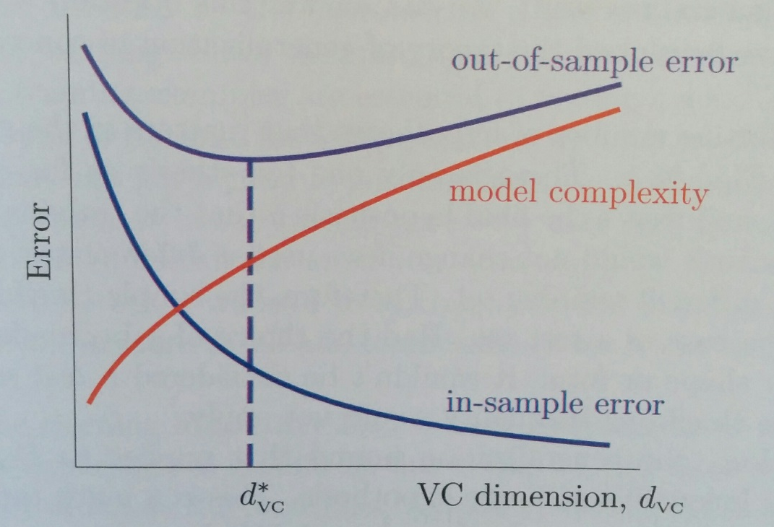
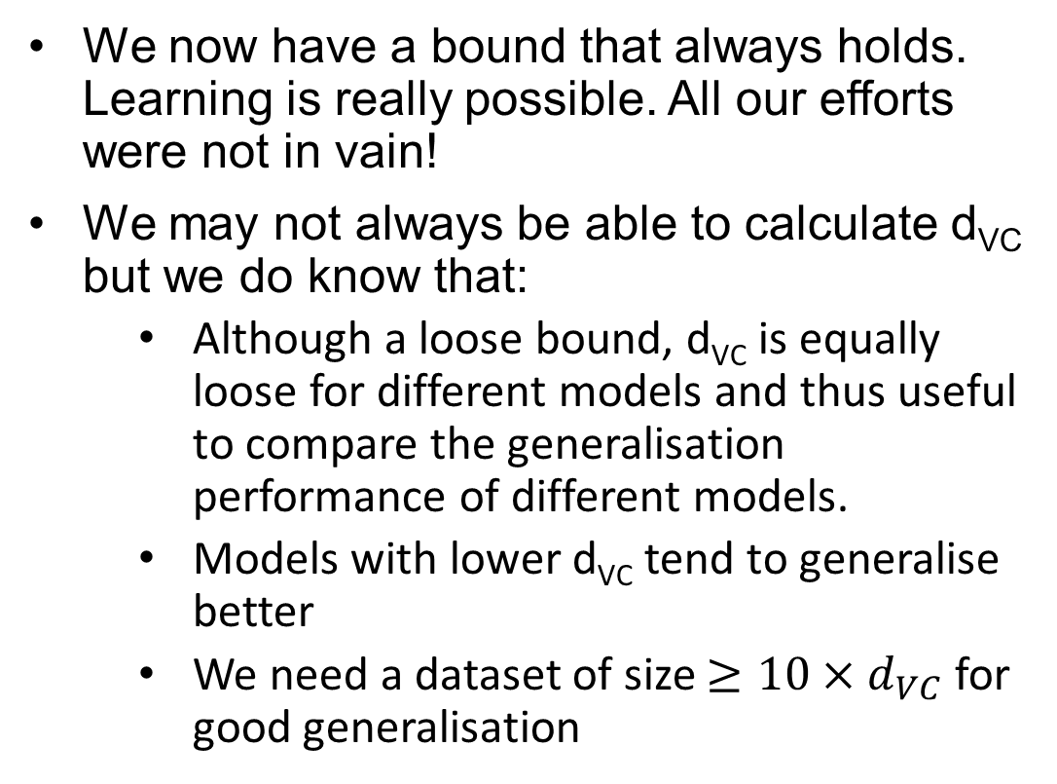
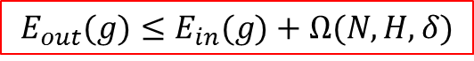
What does d_{VC} tell us?
We now have a bound that always holds. Learning is really possible. All our efforts were not in vain!
We may not always be able to calculate d_{VC} but we do know that:
Although a loose bound, d_{VC} is equally loose for different models and thus useful to compare the generalisation performance of different models.
Models with lower d_{VC} tend to generalise better
We need a dataset of size $≥10×d_{VC}$ for good generalisation
$$E_{out}(g)≤E_{in}(g)+Ω(N,H,δ)$$
Theoretically: d_{VC} shows we need to balance a sufficiently high d_{VC} to reduce E_{in} with a sufficiently low d_{VC} to limit the generalisation error.

Slide 10
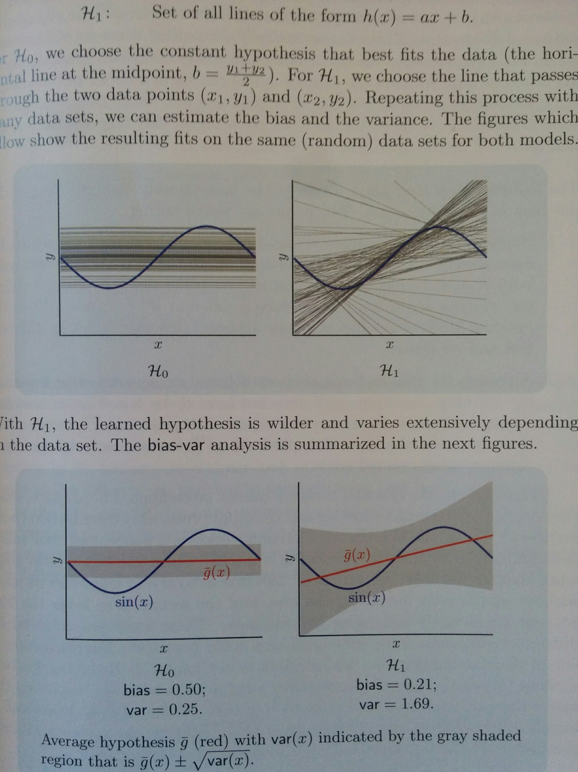
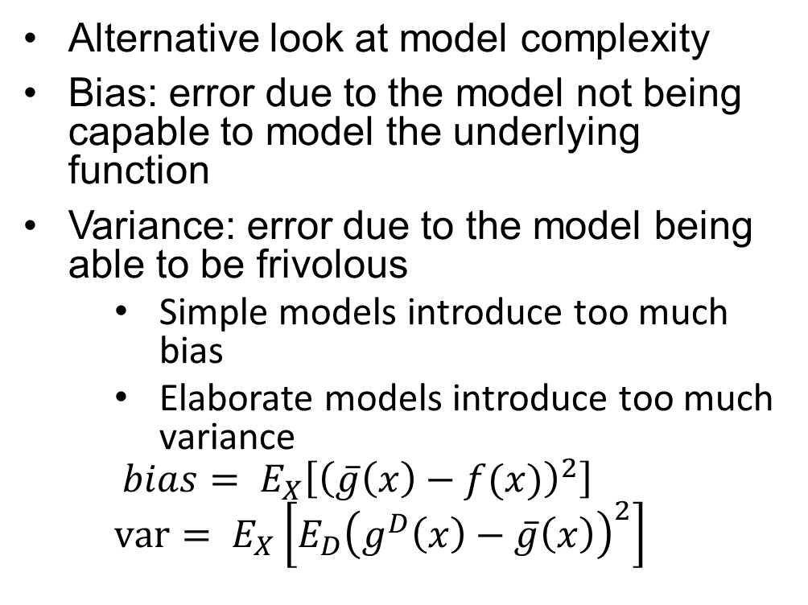
Approximation-Generalisation Trade-off
2 data points!
Alternative look at model complexity
Bias: error due to the model not being capable to model the underlying function
Variance: error due to the model being able to be frivolous
Simple models introduce too much bias
Elaborate models introduce too much variance
$$bias= E_{X}\left[{\left(\overline{g}\left(x\right)−f(x)\right)}^{2}\right]$$
$$var= E_{X}\left[E_{D}{\left(g^{D}\left(x\right)−\overline{g}\left(x\right)\right)}^{2}\right]$$

Slide 11
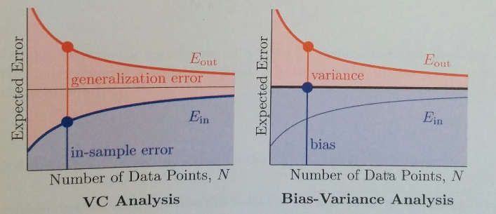
Learning Curves
Show effect of data on ability to learn
Conceptual difference d_{VC} and bias-variance trade-off:
With d_{VC}, E_{out} is treated as E_{in} plus a generalisation error due to the hypothesis set used
With b-v-tradeoff, Eout is treated as sum of bias and variance term due to model complexity and the training algorithm used. E_{in} does not play a role.

Slide 12
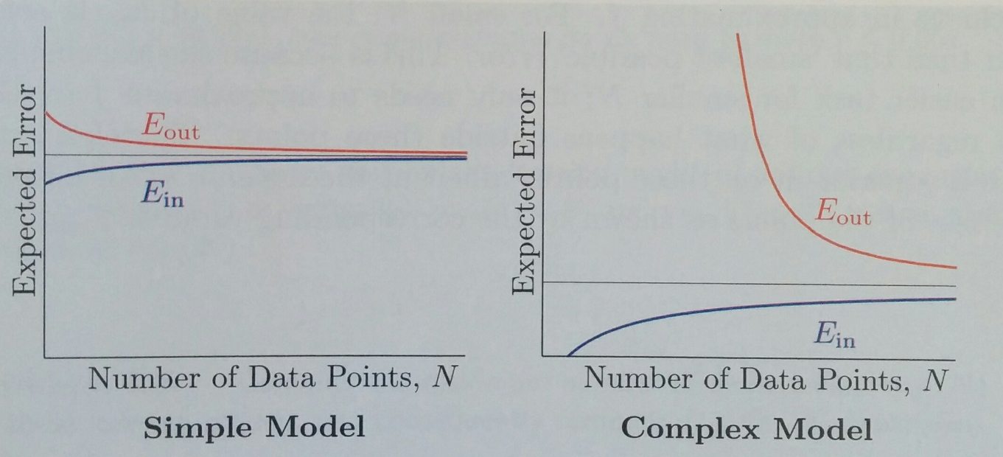
Learning Curves
Simple model
Higher final error
Needs less data for convergence of E_{in} and E_{out}
E_{in} starts with relatively high error
Complex model
Lower final error
Needs more data for convergence of E_{in} and E_{out}
E_{in} starts with low or at zero
E_{out} starts (very) high

